Slide 1
Logical Agents
Fundamentals of Artificial Intelligence
Slides are mostly adapted from AIMA and MIT Open Courseware

Slide 2
Outline
Knowledge-based agents
Wumpus world
Logic in general - models and entailment
Propositional (Boolean) logic
Equivalence, validity, satisfiability
Inference rules and theorem proving
  Resolution
  forward chaining
  backward chaining

Slide 3
Recall
Logical Inference creates new sentences that logically follow from a set of sentences in KB
An inference rule is sound if every sentence S it produces when operating on a KB logically follows from the KB
An inference rule is complete if it can produce every expression that logically follows from (is entailed by) the KB
Notes:
Logical Inference creates new sentences that logically follow from a set of sentences in KB
An inference rule is sound if every sentence X it produces when operating on a KB logically follows from the KB
An inference rule is complete if it can produce every expression that logically follows from (is entailed by) the KB

Slide 4

Resolution
Resolution is a sound and complete inference procedure
If β is True, since we know that ¬ β ˅ γ holds, it must be the case that γ is true
If β is false, then since we know that ɑ ˅ β holds, it must be the case that ɑ is true
So either ɑ or γ is true
Notes:
Now, let’s introduce another inference rule called as resolution
Resolution is a valid inference rule producing a new sentence implied by two sentences containing complementary literals beta and not beta
Recall that a literal is an atomic symbol or its. Negation such as P , ~P
Because beta cannot be both true and false one of the other disjuncts must be true in one of the premises
That is,
If β is True, since we know that ¬ β ˅ γ holds, it must be the case that γ is true
If β is false, then since we know that ɑ ˅ β holds, it must be the case that ɑ is true
So either ɑ or γ is true
Amazingly, resolution is the only inference rule you need to build a sound and complete theorem prover
The resolution rule was discovered by Alan Robinson (CS, University of Syracuse) in the mid 60s

Slide 5


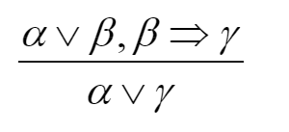
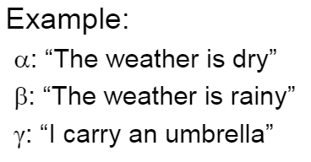
Resolution
or equivalently
Notes:
Note that resolution rule is equivalent to some other forms which are easier to understand
For example let’s consider the rule on the lower right
Think about an example where
Alpha is “the weather is dry”
Beta is “the weather is rainy”
And
Gamma is “I carry an umbrella”
Now, the rule says that
The weather can be dry or rainy, and if it rains I carry an umbrella.
From these premises we can conclude that either the weather is dry or we carry an umbrella

Slide 6
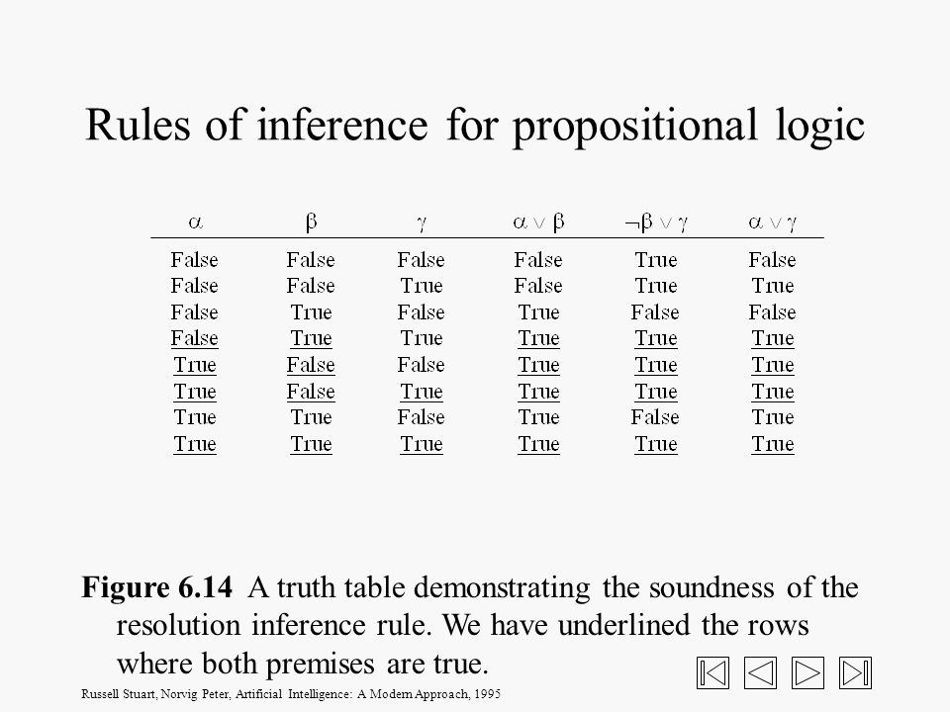
Soundness of the resolution inference rules
An inference rule is sound if the conclusion is true in all cases where the premises are true
Notes:
Recall that an inference rule is sound if the conclusion is true in all cases where the premises are true
To verify soundness of resolution, we therefore construct a truth table with one line for each possible model of the proposition symbols in the premises and show that in all models where the premises are true the conclusion is also true

Slide 7
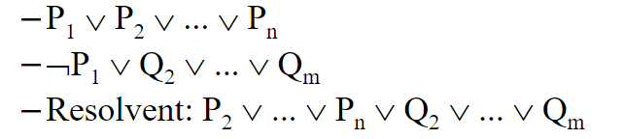
Generalized resolution rule
Where P1 and ¬ P1 are complementary literals
Notes:
The resolution rule can be generalized to disjunctive sentences of any length
We can resolve these two sentences given that P1 and ~P1 are complementary literals

Slide 8
Proof with resolution
Given the following hypotheses:
If it rains, Joe brings his umbrella
(r -> u)
If Joe has an umbrella, he doesn't get wet
  (u -> NOT w)
If it doesn't rain, Joe doesn't get wet
(NOT r -> NOT w)
prove that Joes doesn't get wet (NOT w)

Slide 9
Proof with resolution
We first convert each hypothesis into disjunctions
r -> u
(NOT r OR u)
u -> NOT w
(NOT u OR NOT w)
NOT r -> NOT w
(r OR NOT w)

Slide 10
Proof with resolution
We then use resolution on the hypotheses to
derive the conclusion (NOT w):
NOT r OR u Premise
NOT u OR NOT w Premise
r OR NOT w Premise
NOT r OR NOT w L1, L2, resolution
NOT w OR NOT w L3, L4, resolution
NOT w L5, idempotence

Slide 11
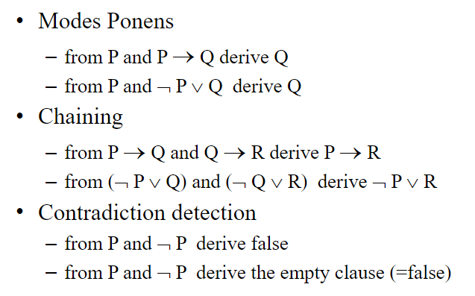
Resolution covers many cases
Notes:
Note that resolution covers many cases that we discussed
Consider Modus ponens where we derive Q from P and P-> Q
Now we can derive Q from P and ~p v Q with resolution.
Similarly we can show that we can replace the implication chain with resolution
One important concept that we will use is contradiction
Remember that if both P and ~P are given, we can derive false
That is P and ~P is false
Now let’s see how we can do it with resolution.

Slide 12
Rewrite
P ≡ P ˅ False
¬P ≡ False ˅ ¬P
Apply resolution (P and ¬ P are complementary literals)
P ˅ False
False ˅ ¬P
False ˅ False False ˅ False ≡ False

Slide 13
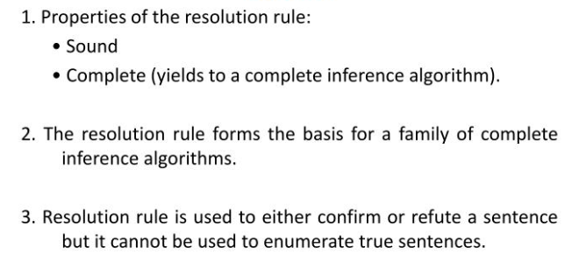
Notes:
We have seen that Resolution rule is sound and complete
And it is the basis for a family of complete inference algorithms
Note that,
Resolution cannot be used to enumerate true sentences
But rather to confirm or refute a sentence

Slide 14
Recall
A sentence is valid if it is true in all models,
KB ╞ α if and only if (KB ⇒ α) is valid
A sentence is unsatisfiable if it is true in no models
α is valid iff ¬ α is unsatisfiable,
(KB ⇒ α) is equivalent to (¬ΚΒ ˅ α )
¬ (KB ⇒ α) is equivalent to (KΒ ∧¬α )
  KB ╞ α if and only if (KB ∧¬α) is unsatisfiable
Notes:
KB implies alpha is logically equivalent to not KB or alpha
And not (KB implies alpha) is equivalent to KB and not alpha
Since a sentence α is valid iff not α is unsatisfiable,
We can now conclude that
KB ╞ α if and only if (KB and not α) is unsatisfiable

Slide 15
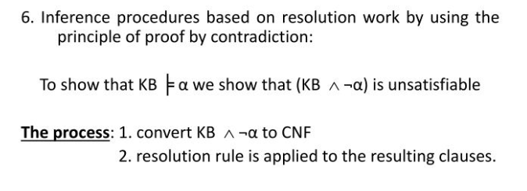
Notes:
Now we will use this fact as our basis for using resolution as a way of proof by contradiction.
To show that KB entails a sentence alpha we will prove that
(KB and not alpha ) is unsatisfiable
That is
We will combine resolution with proof by contradiction
(where we assert the negation of what we wish to prove,
and from that premise derive FALSE) to direct our search towards
smaller and smaller clauses, with the goal of producing FALSE.

Slide 16
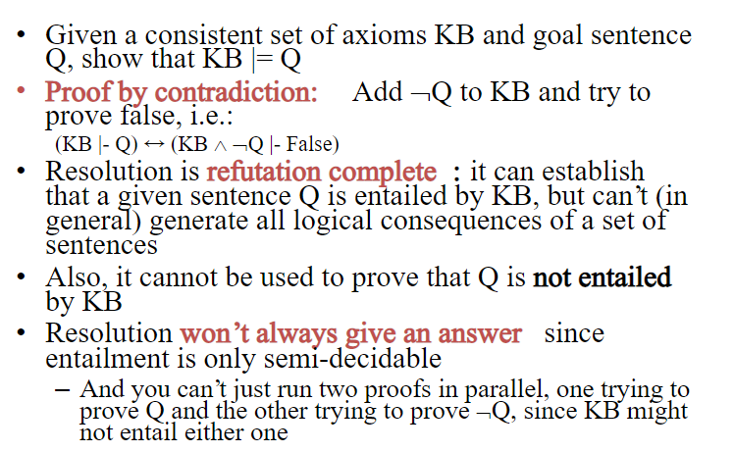
Notes:
Now we will use this fact as our basis for using resolution as a way of proof by contradiction.

Slide 17
Proof by contradiction using resolution
NOT r OR u Premise
NOT u OR NOT w Premise
r OR NOT w Premise
w Negation of conclusion
NOT r OR NOT w L1, L2, resolution
NOT w OR NOT w L3, L5, resolution
NOT w L6, idempotence
FALSE L4, L7, resolution
Notes:
We can redo the previous proof (about Joe and his umbrella)
using proof by contradiction with resolution:

Slide 18
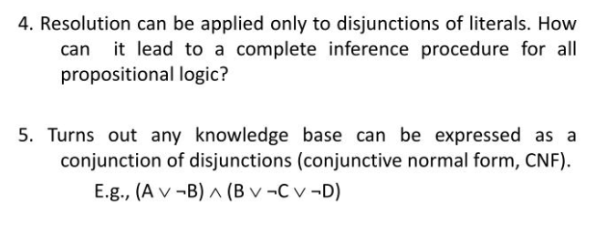

Slide 19
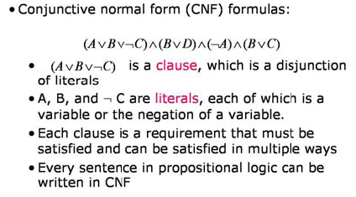
Conjunctive Normal form
Notes:
Remember that a literal is a symbol or negation of a symbol
We call disjunction of literals as a “clause”
Conjunctive normal form (CNF) is a conjunction of clauses
Now, we will show that every sentence in propositional logic can be converted into CNF
By applying a set of steps

Slide 20
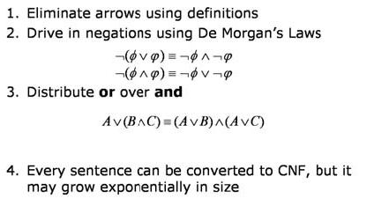
Converting to CNF
Notes:
First, we eliminate the arrows
Both biconditional and implications.
Then we apply negations
And Distribute or over and

Slide 21
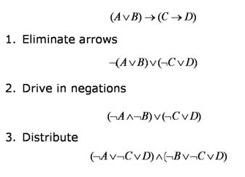
CNF Conversion Example
Notes:
Let’s convert this simple example to CNF
Recall that
A -> b is not a v b
Think about the sentence in the form of p -> q where
P is a v b
And
Q is c -> d
So we convert it into form
Not p or q
Now do this inside the parenthesis as well
~(a v b) v (~c V d)
Now we have to take the negation of (AV b)
Finally we can distribute

Slide 22
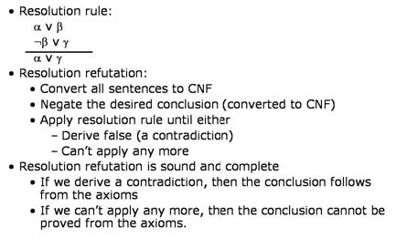
Resolution
Notes:
Now, we have everything to use resolution as our sound and complete inference mechanism

Slide 23
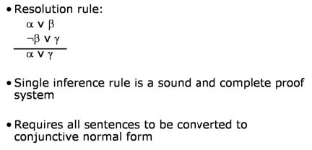
Resolution
Notes:
Resolution rule requires all sentences to be converted into Conjunctive Normal Form

Slide 24
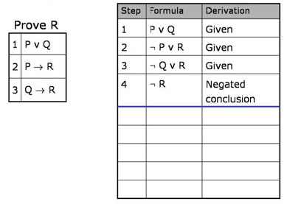
Example
Notes:
Now, consider this example
KB consists of 3 sentences
And we want to prove R
So we add the negated conclusion ~R

Slide 25
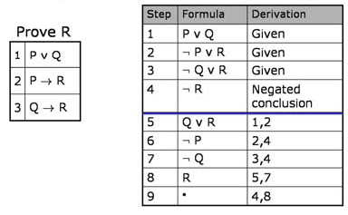
Example
Notes:
Then we converteach sentence into CNF

Slide 26
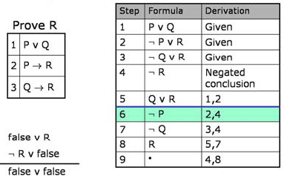
Example
Notes:
At line 8 we have R which is contradictory with ~R
The resolution of R with ~r is false
So we completed our proof by contradiction

Slide 27
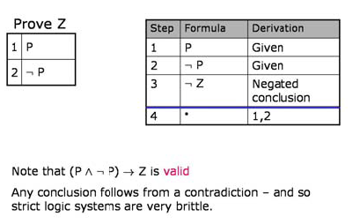
The power of false
Notes:
Now, note that if you have a KB which is contradictory by itself
You can reach any conclusion
This shows that strict logic systems are brittle

Slide 28
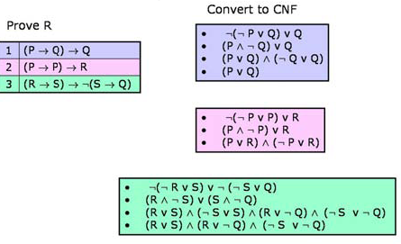
Example
Notes:
Now, work on a harder example
We have 3 sentences in our KB and want to prove R
We convert each sentence in our KB into CNF first

Slide 29
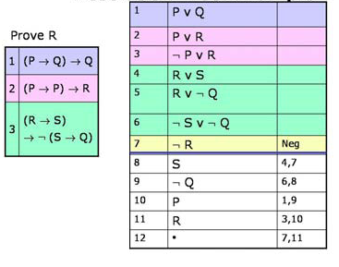
Example
Notes:
Then we add the negated conclusion ~R
Apply resolution to conclude about contradiction

Slide 30
Resolution
Conjunctive Normal Form (CNF)
  conjunction of disjunctions of literals
  clauses
  E.g., (A ∨ ¬B) ∧ (B ∨ ¬C ∨ ¬D)
Resolution inference rule (for CNF):
l_{i} ∨… ∨ l_{k}, m₁ ∨ … ∨ m_{n}
l_{i} ∨ … ∨ l_{i-1} ∨ l_{i+1} ∨ … ∨ l_{k} ∨ m₁ ∨ … ∨ m_{j-1} ∨ m_{j+1} ∨... ∨ m_{n}
where l_{i} and m_{j} are complementary literals.
E.g., P_{1,3} ∨ P_{2,2}, ¬P_{2,2}
P_{1,3}
Resolution is sound and complete
for propositional logic

Slide 31

Conversion to CNF
Givem
B_{1,1} ⇔ (P_{1,2} ∨ P_{2,1})
¬B_{1,1}
Prove: P_{1,2}
Eliminate ⇔, replacing α ⇔ β with (α ⇒ β)∧(β ⇒ α).
  (B_{1,1} ⇒ (P_{1,2} ∨ P_{2,1})) ∧ ((P_{1,2} ∨ P_{2,1}) ⇒ B_{1,1})
2. Eliminate ⇒, replacing α ⇒ β with ¬α∨ β.
  (¬B_{1,1} ∨ P_{1,2} ∨ P_{2,1}) ∧ (¬(P_{1,2} ∨ P_{2,1}) ∨ B_{1,1})
3. Move ¬ inwards using de Morgan's rules and double-negation:
  (¬B_{1,1} ∨ P_{1,2} ∨ P_{2,1}) ∧ ((¬P_{1,2} ∧ ¬P_{2,1}) ∨ B_{1,1})
4. Apply distributivity law (∧ over ∨) and flatten:
  (¬B_{1,1} ∨ P_{1,2} ∨ P_{2,1}) ∧ (¬P_{1,2} ∨ B_{1,1}) ∧ (¬P_{2,1} ∨ B_{1,1})
Notes:
Finally, let’s now work on our Wumpus world example
First, convert our sentences into CNF

Slide 32

Resolution example
KB = (B_{1,1} ⇔ (P_{1,2}∨ P_{2,1})) ∧¬ B_{1,1} α = ¬P_{1,2}
Notes:
Now, let’s put each clause into a box
We will generate new boxes (clauses) by connecting two other by applying resolution
Although we did not use some of the clauses
at the end, we were able to reach the contradiction, and proved that KB entails the conclusion

Slide 33
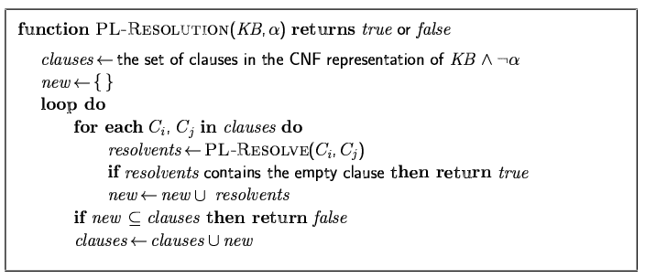
Resolution algorithm
Proof by contradiction, i.e., show KB∧¬α unsatisfiable
Notes:
This is actually how we write the resolution algorithm

